Slide 1

Lead Scoring Case Study
By-
Swati kumar
Sambit sekhar sahu

Slide 2
“Start by doing what’s necessary, then what’s possible and suddenly you are doing the impossible’’
- Saint Francis

Slide 3
PROBLEM STATEMENT
An education company named X Education sells online courses to industry professionals & the typical lead conversion rate is around 30%. Although the company gets a lot of leads, its lead conversion rate is very poor.
To make this process more efficient, the company wishes to identify the most potential leads, also known as ‘Hot Leads’. If they successfully identify this set of leads, the lead conversion rate should go up as the sales team will now be focusing more on communicating with the potential leads rather than making calls to everyone.

Slide 4
OBJECTIVE
The objective is to help X Education select the most promising leads by building a model and assigning a lead score to each of the leads such that the customers with higher lead score have a higher conversion chance and the customers with lower lead score have a lower conversion chance.
The CEO, in particular, has given a ballpark of the target lead conversion rate to be around 80%.
Model Building
Predicting Hot Leads
Higher Conversion Rate

Slide 5
APPROACH OF ANALYSIS
Data Reading & Understanding
Data Cleaning
Exploratory Data Analysis
Data Preparation
Model Building
Model Evaluation

Slide 6
Data Reading & Understanding
Firstly, we imported the data & stored it into a data frame.
Then we looked at its shape, size, info, & description to begin with.

Slide 7
Data Cleaning
Those columns with null value percentages greater than 40% were removed.
Categorical columns having only one category were removed, as they won’t be helpful for analysis.
Columns having highly skewed data were also removed, to counter any possible data-imbalance.
Columns having too many sub-category levels were treated so that when dummy variables are created, we don’t have too many dummy variables to deal with. Sub-category levels having very low frequency were clubbed into one group.
Apart from column wise null value analysis, row wise null value analysis was also done. Rows having greater than 50% null value presence were removed (if any).
Finally proper null value imputation technique was used.

Slide 8
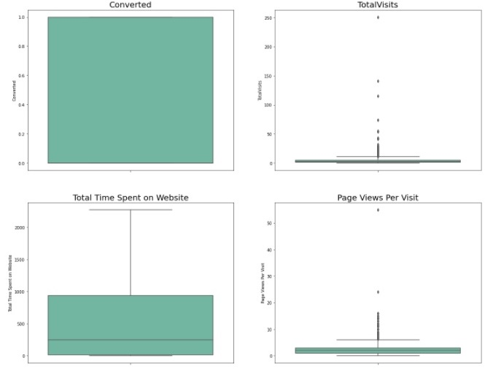
Outlier Treatment
'TotalVisits' and 'Page Views Per Visit’ had outliers and were treated.
Here is the attached box plot of the columns after outlier treatment is done.

Slide 9
Exploratory Data Analysis
After data cleaning we proceeded with EDA where we took a closer look at different variables to observe features in detail.
We found out sales team specific generated data won’t be helpful in analysis as the model being built will be used by sales team before hand to identify Hot leads. So, we removed those columns (if any present till EDA) before moving onto Data Preparation.

Slide 10
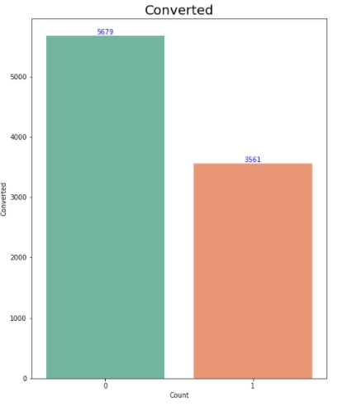
Conversion rate from previous data
From the graph we can observe the conversion rate to be 38.5%

Slide 11
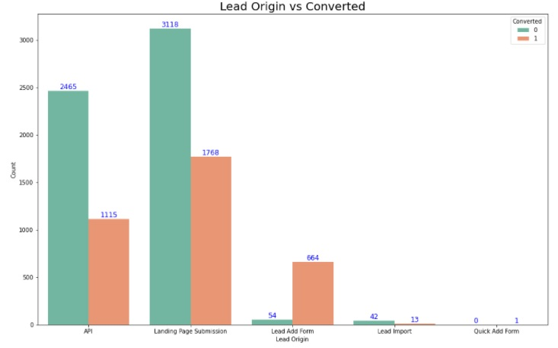
Lead Origin vs Converted
From the graph we can see that the maximum conversion happened by landing page submission.

Slide 12
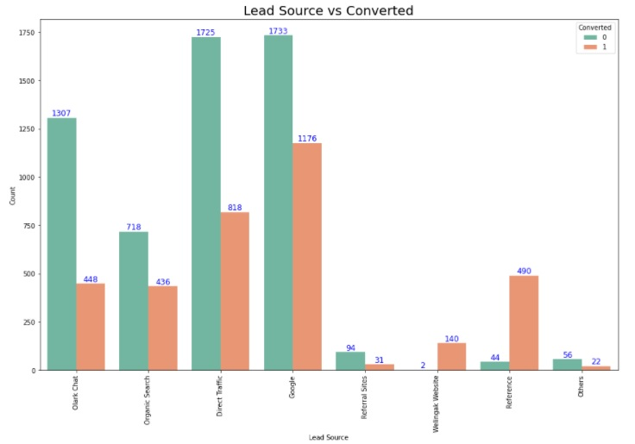
Lead Source vs Converted
From the graph we can see Google contributed the most in lead conversion

Slide 13
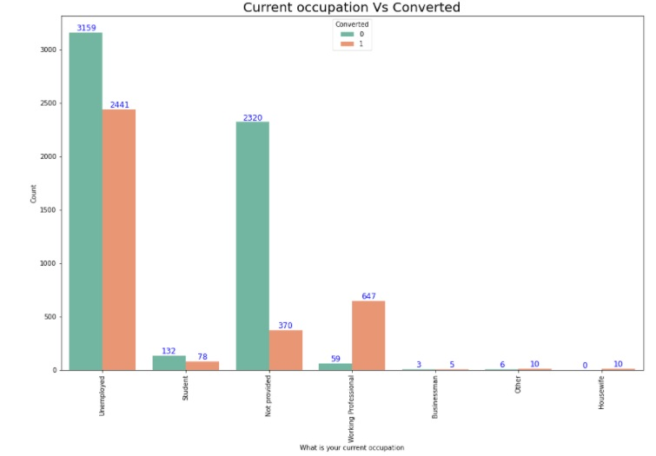
Current Occupation vs Converted
As we can see, more conversions happened for unemployed.
Also 10 housewives applied and all got converted.

Slide 14
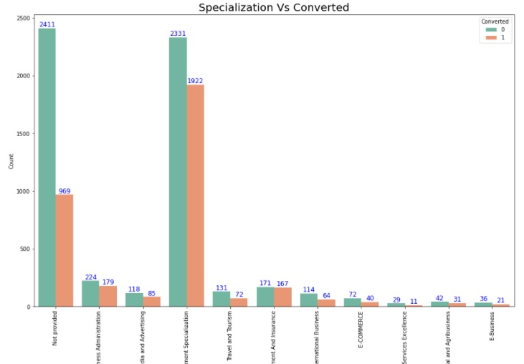
Specialization vs Converted
As we can see, the most conversions happened when specialization is 'Management Specialization'.

Slide 15
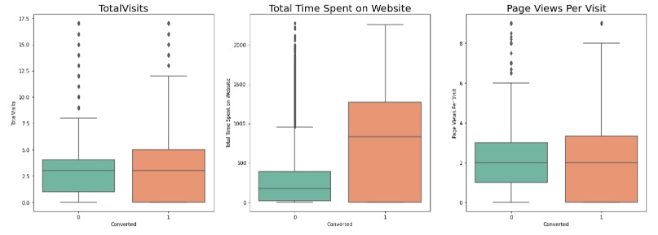
Numerical Features vs Converted
Median for converted and not converted leads is almost same in the case of 'TotalVisits' and 'Page Views Per Visit'.
It seems leads spending more time on the website have more chances of getting converted.

Slide 16
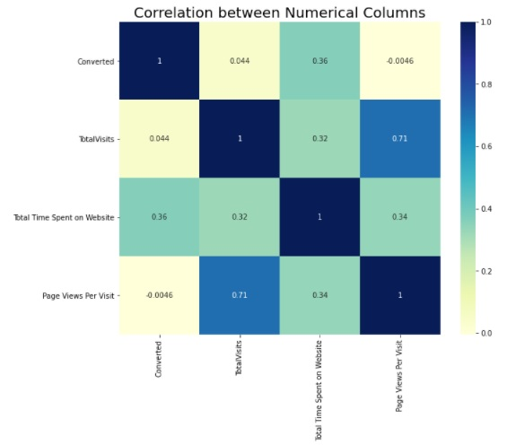
Correlation between Numerical Features
Correlation of 'TotalVisits' and 'Page Views Per Visit' is the highest.
'Converted' has a decent correlation with 'Total Time Spent on Website'.

Slide 17
Data Preparation
Dummy variables were created for categorical columns having different sub-category levels.
For numerical columns scaling was done using Standard Scaler to bring data into one scale.
Data was split into Train & Test sets with 70-30 ratio.

Slide 18
Model Building
Balanced approach was used while building the model i.e., Automated (RFE) + Manual Feature Elimination (p-value & VIF).
Firstly, RFE was used to attain top 20 features.
Then p-value & VIF value were used with backward feature elimination method i.e., one feature was removed at a time until we reached optimum model with all features having p-value < 0.05 and VIF value < 3.

Slide 19
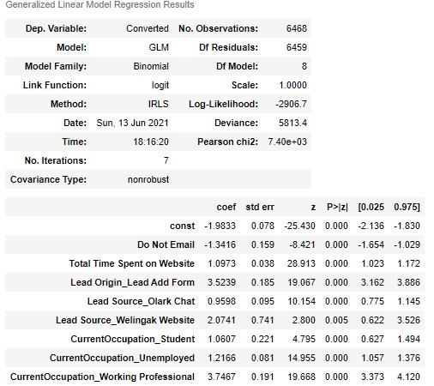
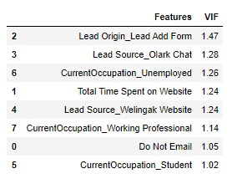
P-value & VIF value for Final features

Slide 20
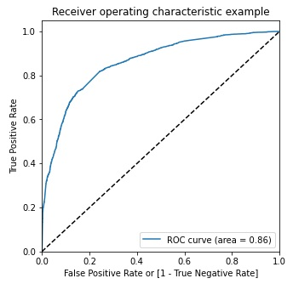
ROC Curve

Slide 21
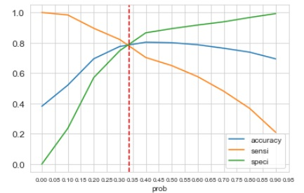
Finding Optimal Cut-off
From the graph, the point where accuracy, sensitivity & specificity intersect gives the optimal cut-off.
0.314 is the optimal cut-off.

Slide 22
Model Evaluation
To check the model’s performance, the model was trained on train set & was then tested on test set.
Parameters like Sensitivity, Specificity, Accuracy, Precision & Recall were used for evaluating model performance.

Slide 23
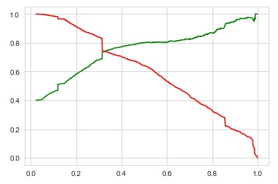
Plotting to Observe trade-off between Precision & Recall

Slide 24
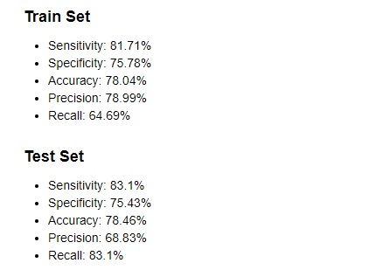
Result

Slide 25
Conclusion
Top 3 Variables that contributed the most towards the probability of a lead getting converted-
CurrentOccupation_Working Professional
Lead Origin_Lead Add Form
Lead Source_Welingak Website
Lead conversion rate: 83.10%

